Slide 1
Accuracy Requirements for Imaging Spectroscopy to Meet the Decadal Survey’s Most Important Objectives for Snow in the Water Cycle
Jeff Dozier, UC Santa Barbara David R. Thompson, JPL Edward H. (Ned) Bair, Leidos Niklas Bohn, JPL

Slide 2
Background
Reflectivity (broadly defined) of deep snow
Darker when grains are larger, mainly in the near-infrared
Darker when contaminated by light-absorbing particles (LAP), mainly in the visible
Usually different than other surfaces like vegetation or soil

Slide 3
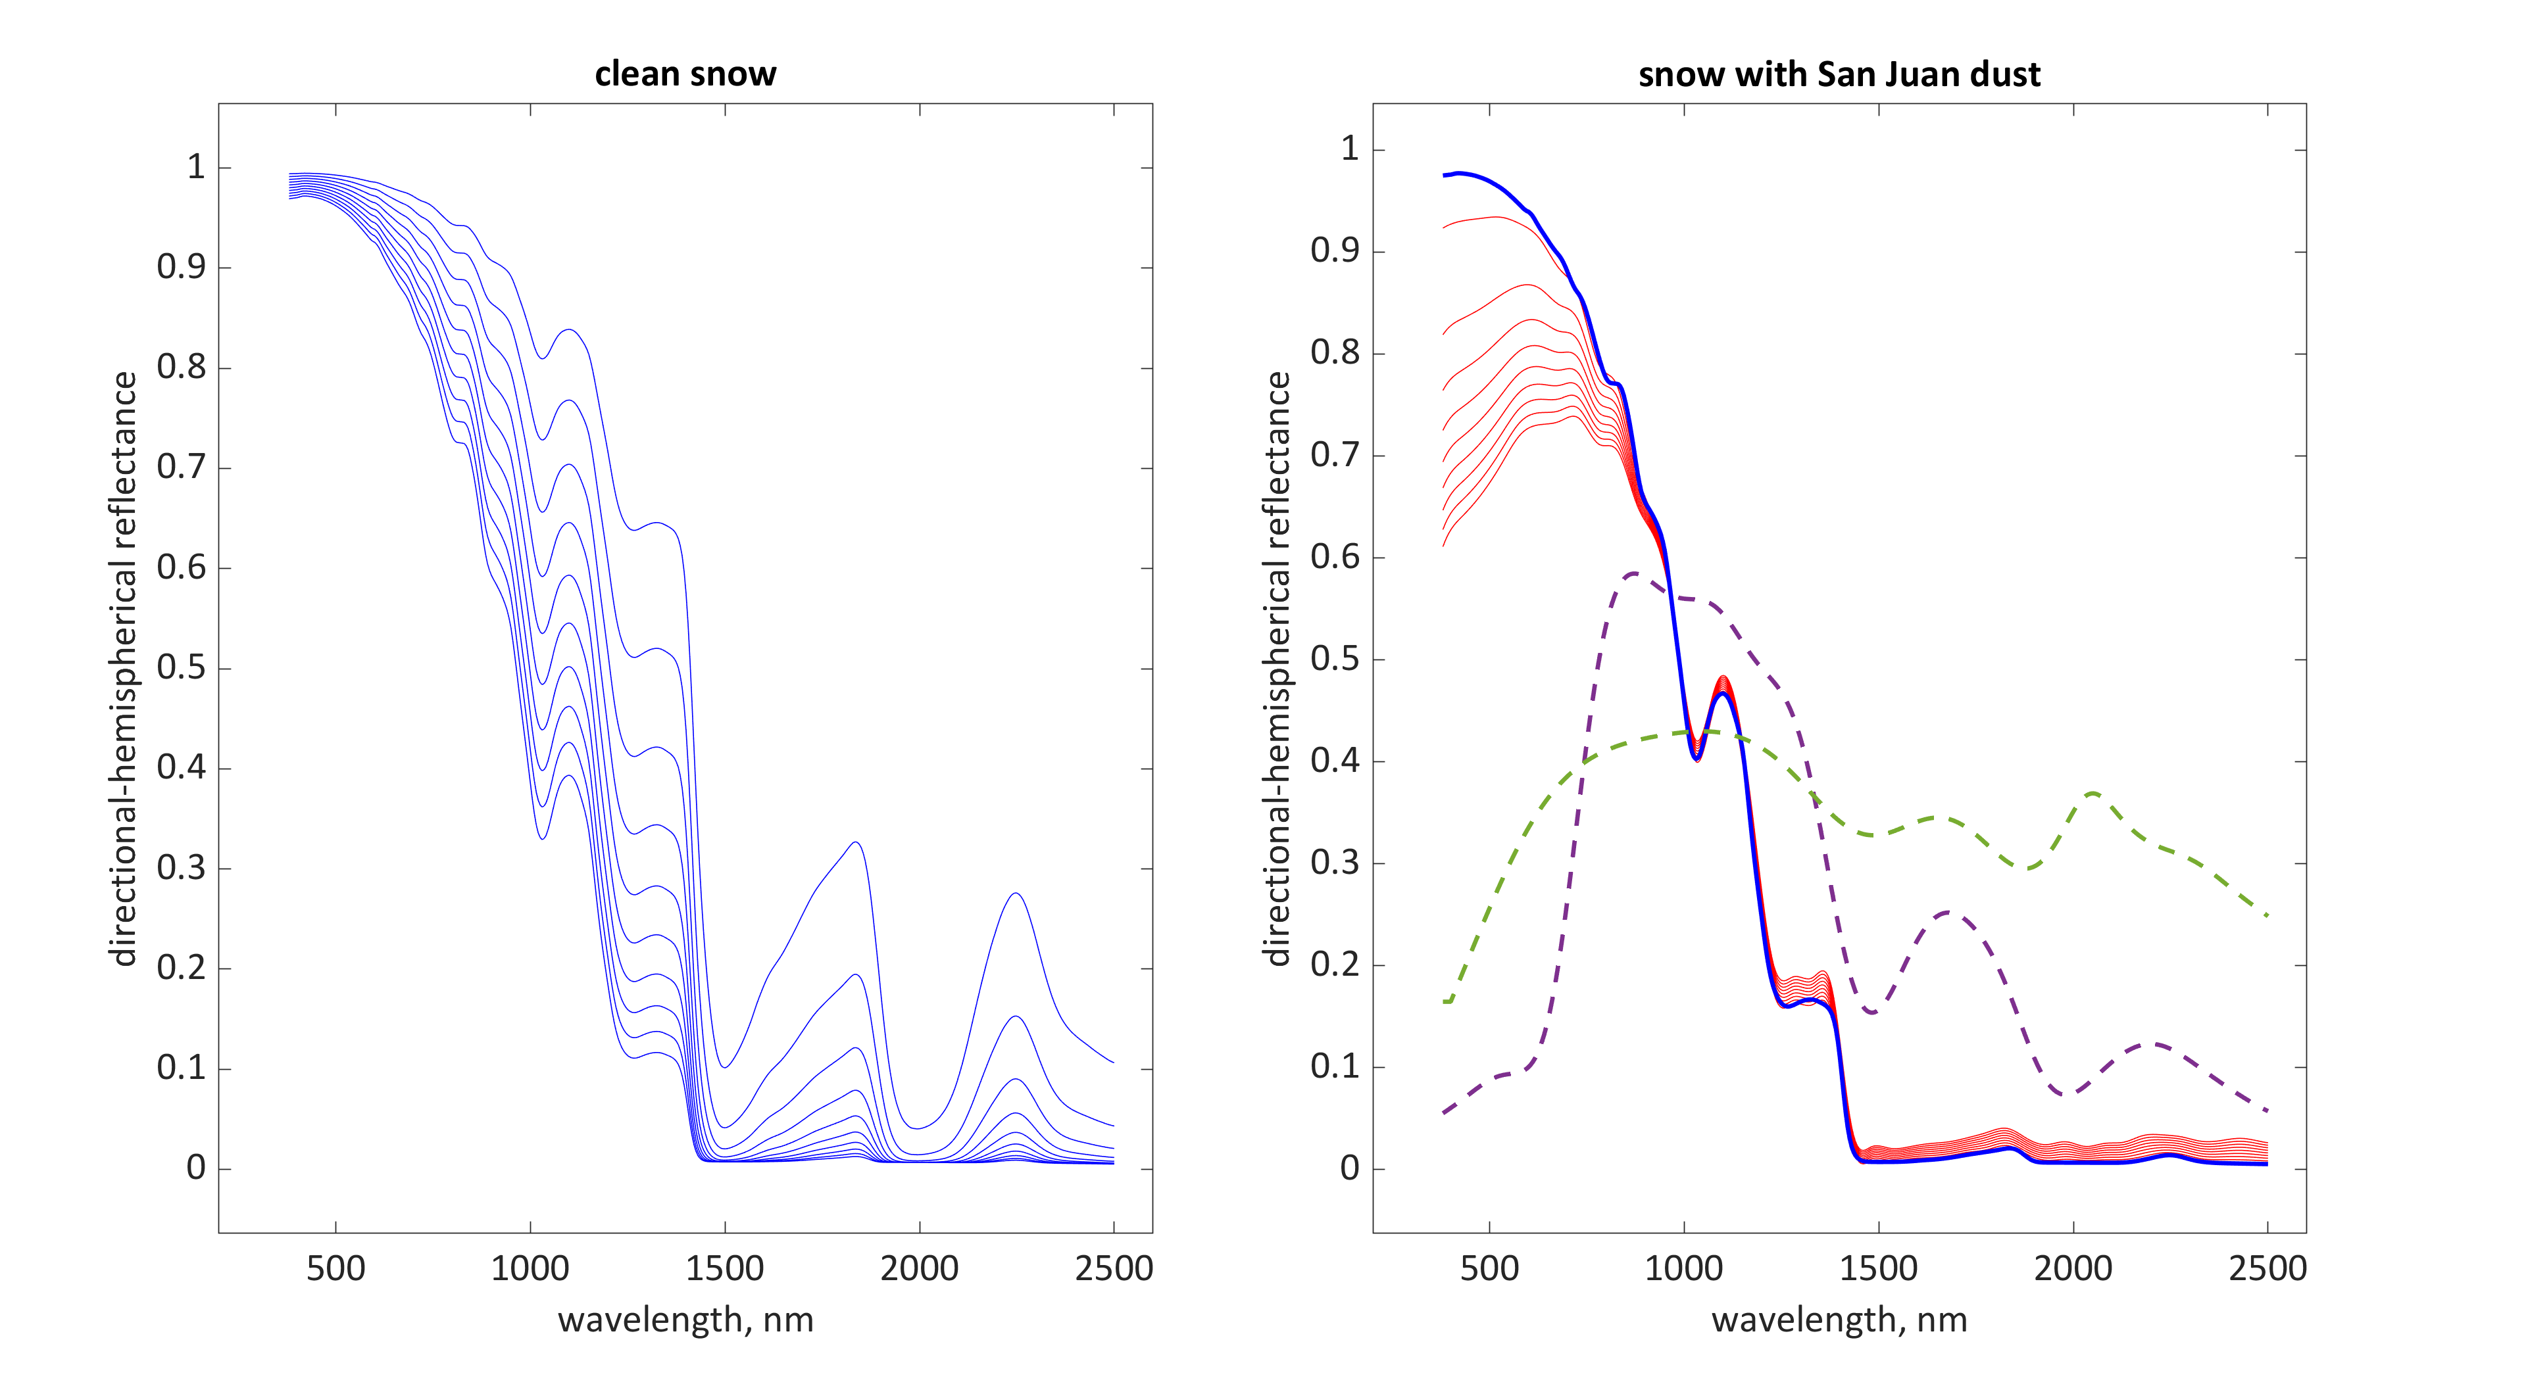
Illumination 60° Snow radii 50 to 1500 µm
clean
Snow radius 1000 µm LAP conc. 10 to 500 ppmw
(from ECOSTRESS)
Pine spectrum
Entisol spectrum

Slide 4
What does the Decadal Survey say?
Specific need for measurement of snow albedo:
“Spectral albedo of subpixel snow and glaciers at weekly intervals to an accuracy to estimate absorption of solar radiation to 10%”
Note that measurement of absorption to ±10% is a more stringent requirement than measuring albedo to that accuracy
Consider an albedo of 0.8, so absorption (1–albedo) = 0.2. Reduce albedo by 10% (to 0.72), absorption = 0.28, an increase of 40%.
Implication: You really don’t care about albedo, you care about absorption (1–albedo)

Slide 5
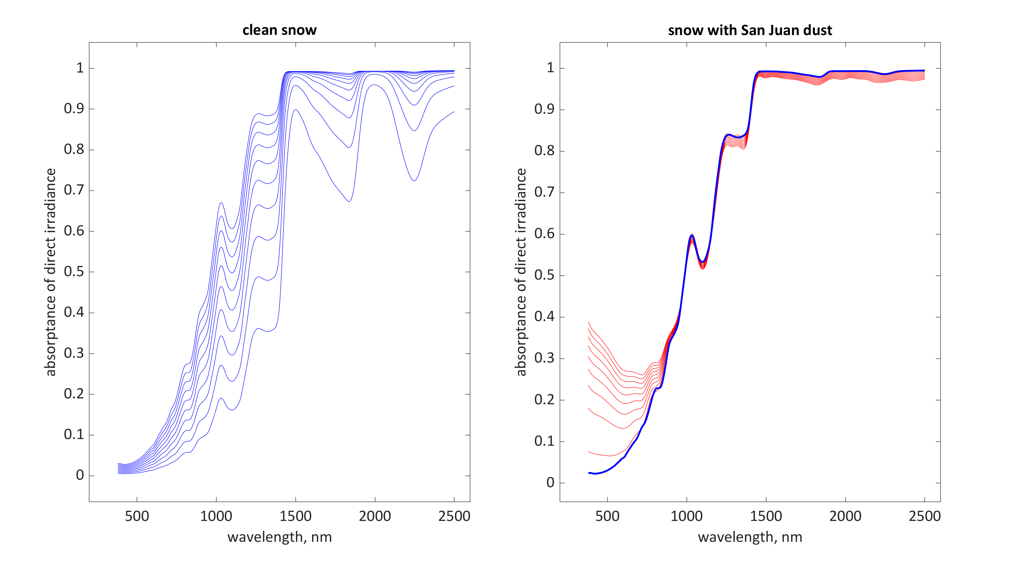
Snow radius 1000 µm LAP conc. 10 to 500 ppmw
Illumination 60° Snow radii 50 to 1500 µm
clean

Slide 6
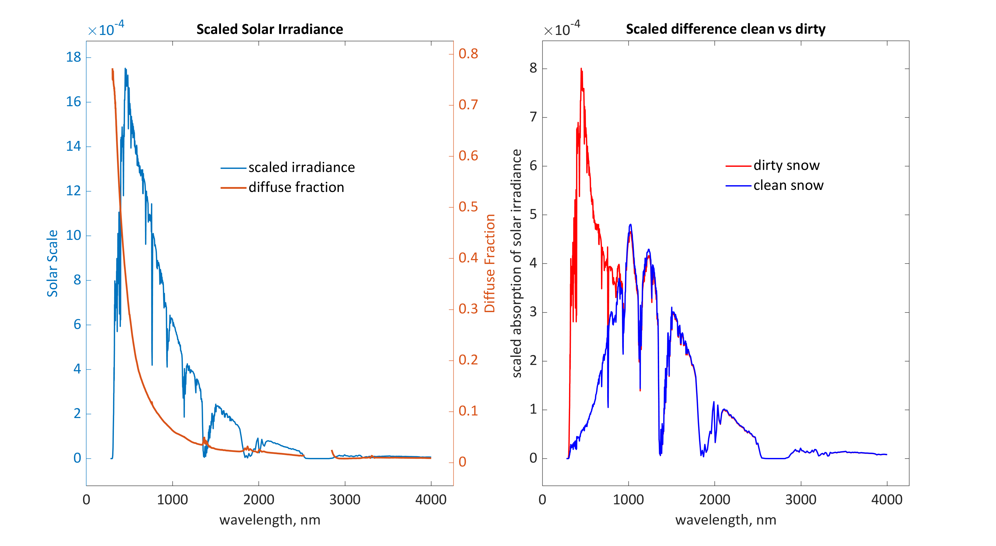
Radiative forcing (spectral)
Snow radius 1000 µm LAP conc 500 ppmw
Mid-latitude winter atmos
Solar zenith = 60°
Elevation = 3000 m

Slide 7
Requirement addresses integration over solar spectrum
Integral of absorbed solar radiation over 280-4000 nm sensitive to grain size and light-absorbing particles
Define grain size accuracy in terms of the square root of the effective radius, whereas absorption vs. radius itself is nonlinear

Slide 8
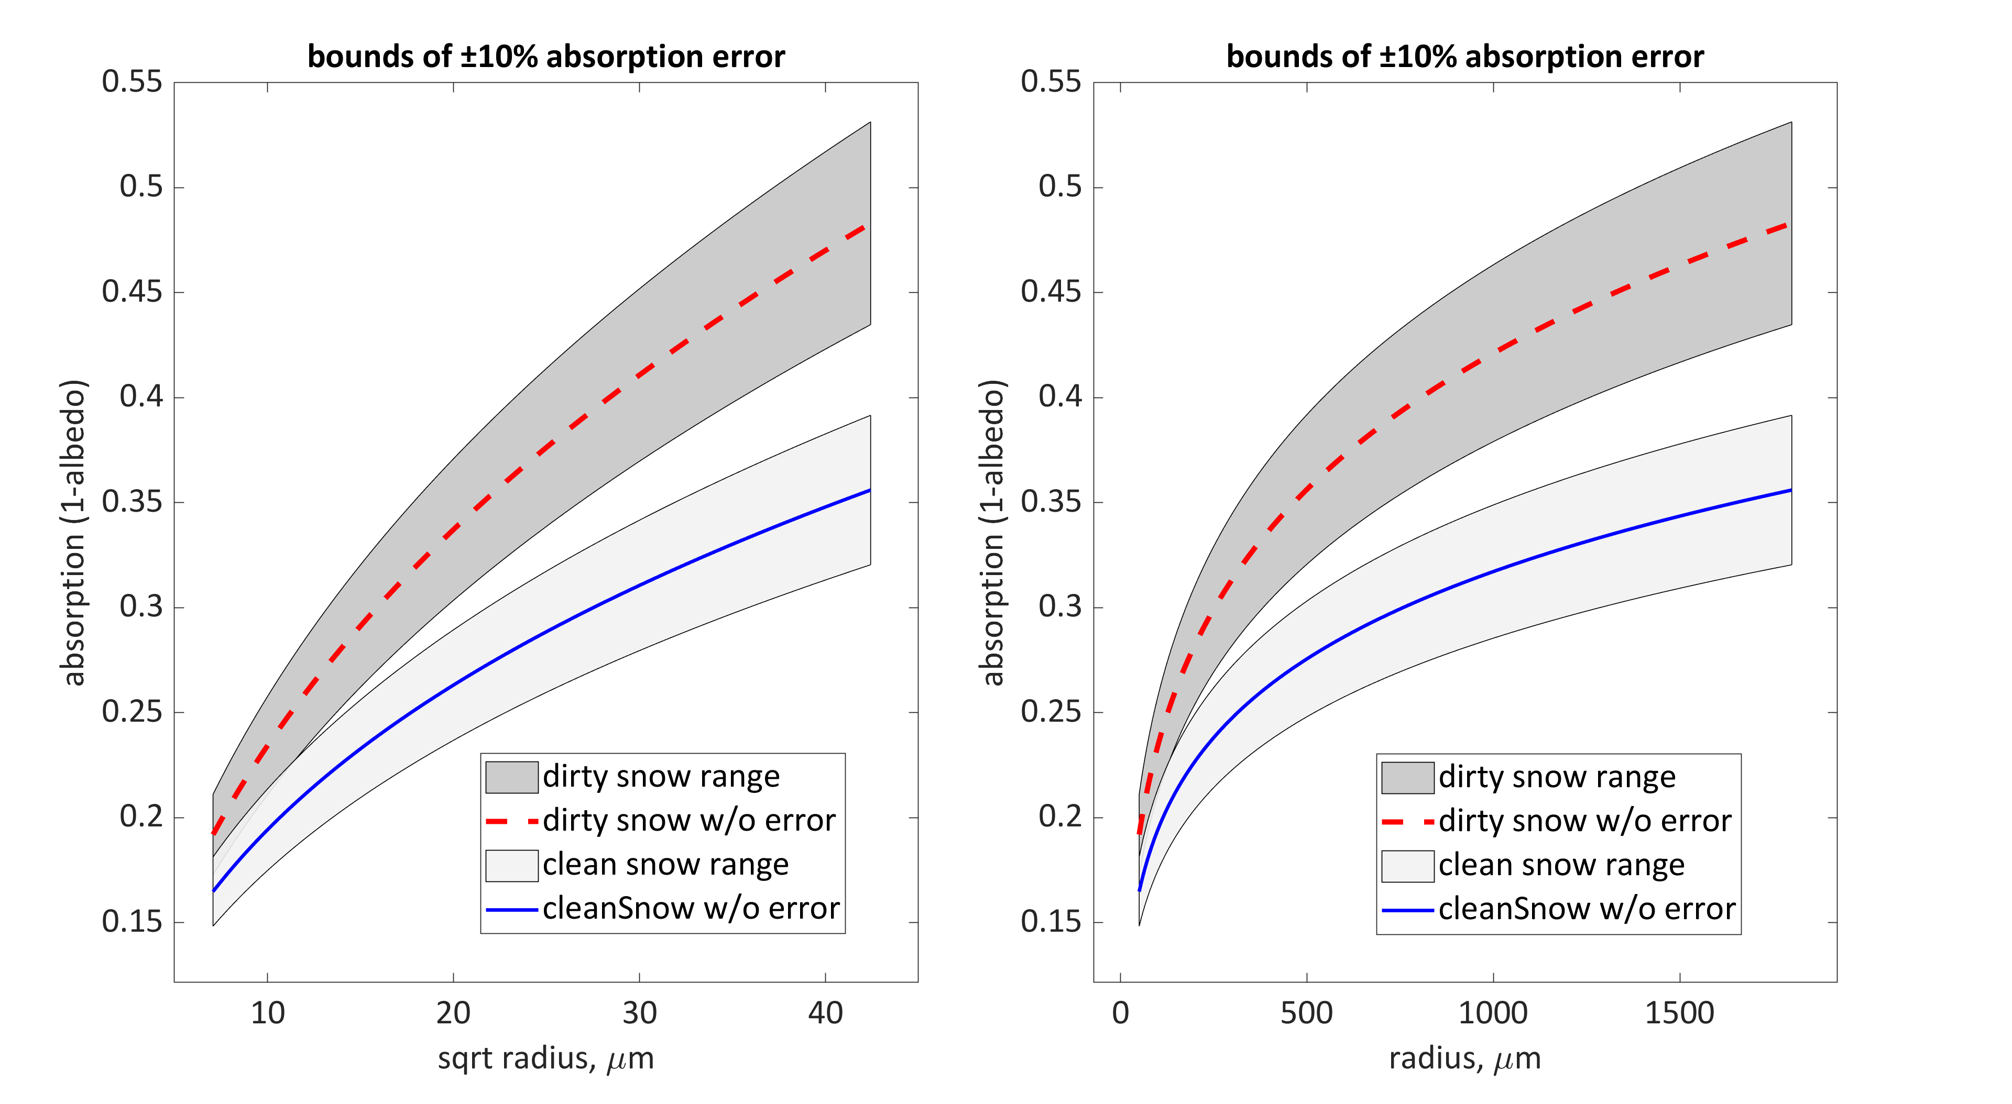
But absorption = f$\left(\sqrt{\text{radius}}\right)$ is nearly linear
absorption = f(radius) is nonlinear

Slide 9
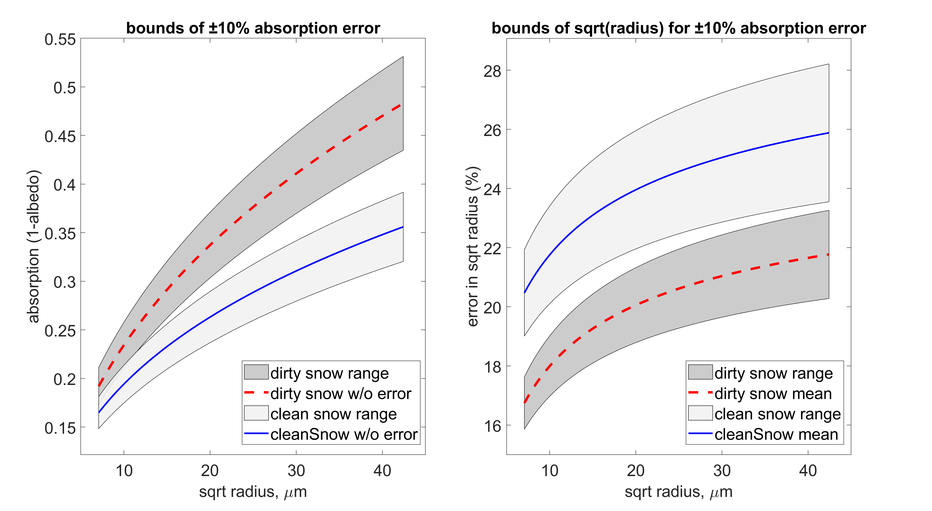
$$\text{absorption}\text{ @ }{\text{θ}}_{\text{0}}\text{6}\text{0°, }{\text{θ}}_{\text{S}}\text{ 50°} \\ {\text{f}}_{\text{LAP}}\text{ 200 }\text{ppmw} \text{San} \text{Juan} \text{Dust}$$
Why is dirty snow more sensitive to uncertainty in grain size?

Slide 10
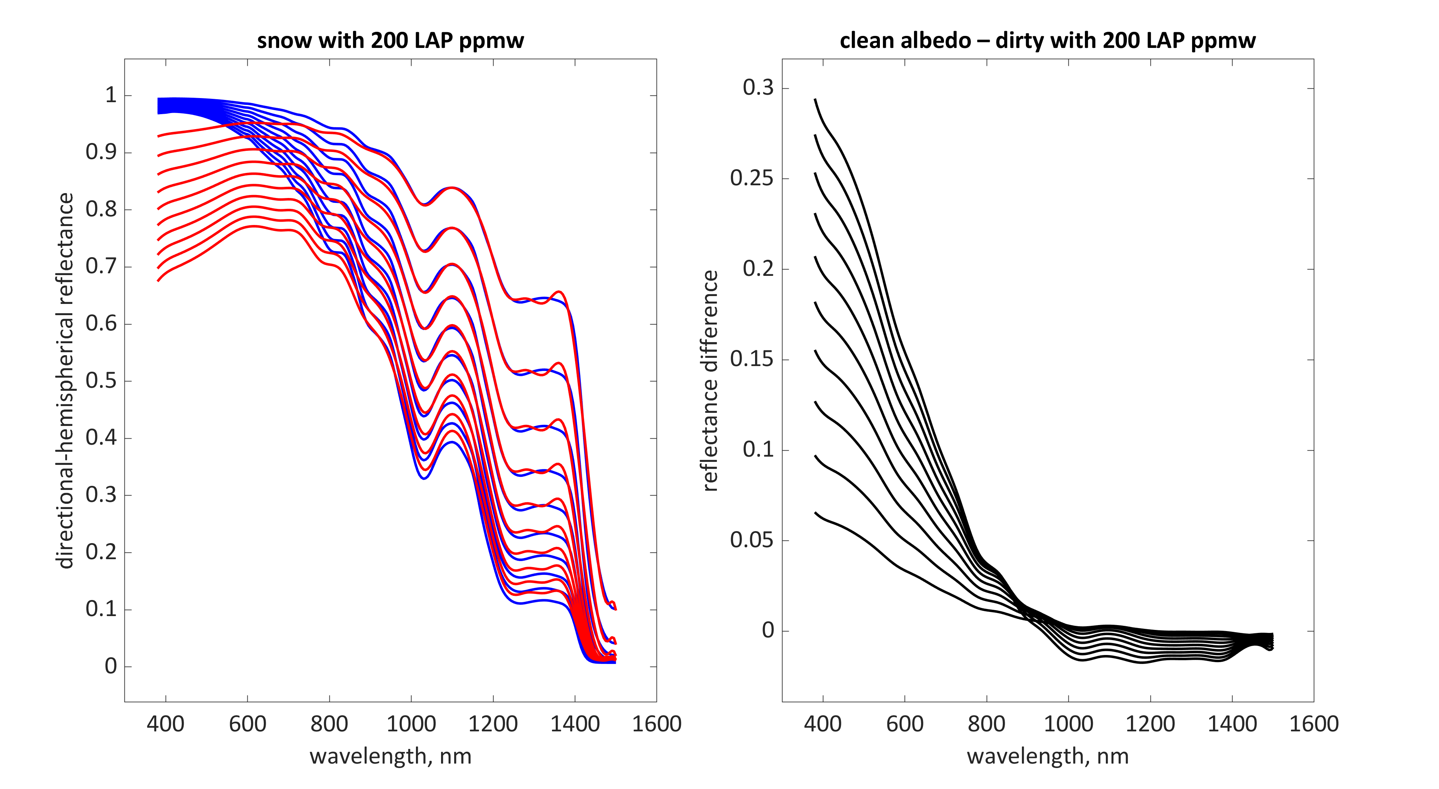
clean
Radiative forcing: convolve spectral reflectance difference with solar spectrum and integrate over wavelength
dirty
Integrating albedo difference over 400-900 nm defines “darkening”
Grain radius from 50 to 1500 µm, LAP conc. 200 ppmw

Slide 11
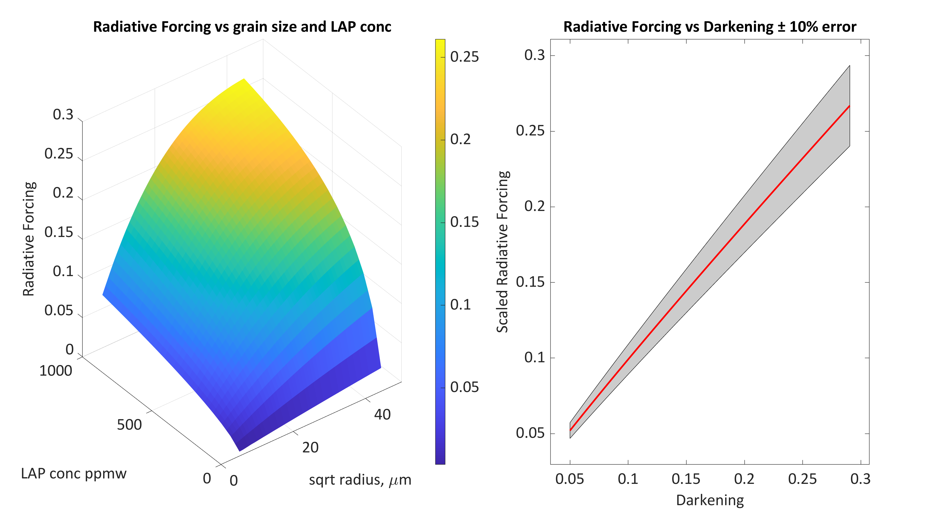
Relationship is linear and about 0.8:1, so getting radiative forcing to ± 10% depends on getting darkening to ± 12%

Slide 12
Recommendation to meet the specifications in the Decadal Survey
The Science/Applications Traceability Matrix for NASA’s SBG mission (Surface Biology and Geology) should:
Specify that the sensor, data processing, and algorithms retrieve square root of effective radius of snow grains to within 18% RMS error
And that the “darkening” of snow—the difference between estimated clean albedo and actual albedo integrated over wavelengths 400 to 900 nm—is retrieved to within 12% RMS error
(these thresholds to be explored under a range of illumination conditions and fractional snow-covered area)
Effects of sensor calibration and atmospheric correction should be evaluated in this context

Slide 13
Slides posted at https://snow.ucsb.edu

Slide 14
Emails, just in case
Jeff: dozier@ucsb.edu
Ned: edward.h.bair@leidos.com
Niklas: urs.n.bohn@jpl.nasa.gov
David: david.r.thompson@jpl.nasa.gov

